Slide 1

LIGHTS CAMERA ACTION
The Night of the AdEaters is
Cinema, show time, a statement of our times, a common language for all audience
An international festive advertising show offering 3 hours of non-stop action showing some of the most amazing, funniest, most artistic and most creative advertising films from around the world.

Slide 2




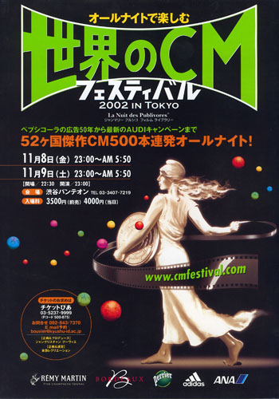
RUNNING SUCCESSFULLY,ALL OVER THE WORLD
AMMAN
ZAGREB
BEIRUT
MEXICO
TOKYO
From its birthplace in France in 1981, The Night of the AdEaters has become an established and anticipated annual event covering 160 cities, across 47 countries.
The Night of the AdEaters celebrates its 25th year with the first ever screening in Muscat, Oman.

Slide 3
FIRST DAY FIRST SHOW
The first ever-international Festival of Advertising of
its kind to be hosted in Muscat.
Two nights full of surprises for new audiences who participate unreservedly in a party-like atmosphere.
More than 200 of the finest, amazing and funniest
advertising films from the whole world set to a devilish rhythm

Slide 4
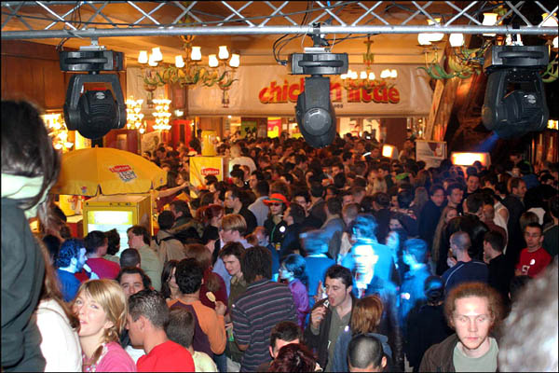
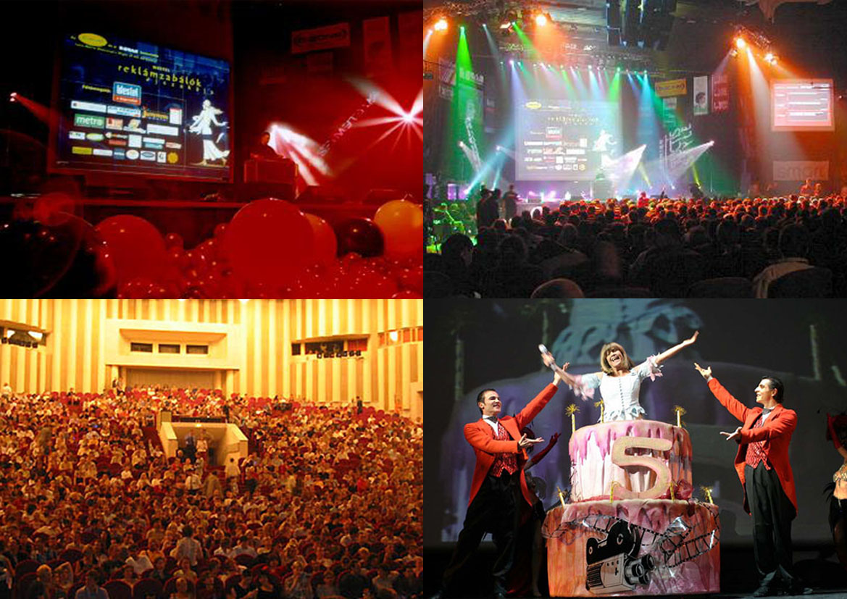
THE NIGHT OF THE ADEATERS
cult event
A language shared
by all audiences
concert
Cinema

Slide 5
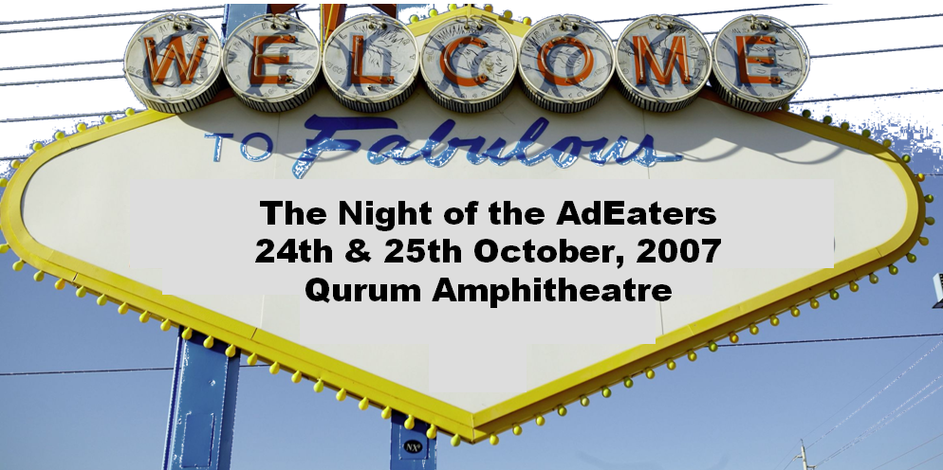
COMING SOON…

